Slide 1

HTML5 Geolocation API and Google Maps
L13 – Place to Eat
C273 – Advanced Web Applications Development in PHP

Slide 2
Today's problem
Create a functional 1 page website for Place to Eat using jQuery, AJAX, PHP, Bootstrap, HTML5 Geolocation API and Google Maps.
restaurantsMap.html – Retrieve all restaurants and displays their location in a map. Add new restaurant information by allowing the user to select his current location or click a location in the map.

Slide 3
HTML5 Geolocation API and Google Maps
HTML5 Geolocation API can be used to find a user’s geographical location.
Google Maps API can be used to:
Show maps
Customize maps
Do Geocoding and reverse Geocoding

Slide 4
Latitude / Longitude
Latitude:
Position of a location on Earth north or south of the equator
Positive on Northern Hemisphere
Negative on Southern Hemisphere
Longitude:
Position of a location on Earth east or west of Greenwich, UK
Positive when east of Greenwich
Negative when west of Greenwich

Slide 5
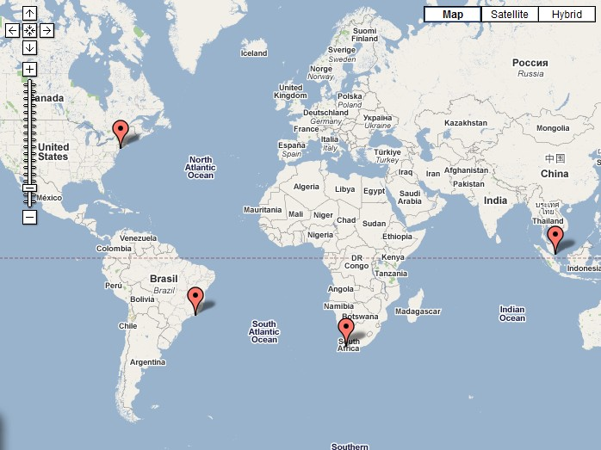
 | City | Latitude | Longitude
 | New York | 40.7 | -74.0
 | Rio de Janeiro | -22.9 | -43.2
 | Cape Town | -33.9 | 18.41
 | Singapore | 1.3 | 103.8

Slide 6







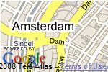


Zoom Level
Defines how far you zoom in to a map
Zoom level 0: Entire world in one map
Zoom level 18: Individual buildings
Level 0
Level 2
Level 4
Level 6
Level 8
Level 10
Level 12
Level 14
Level 16
Level 18

Slide 7
My First Map
<!DOCTYPE html>
<html>
<head>
<title>TODO supply a title</title>
<meta charset="UTF-8">
<style type="text/css">
html, body, #map_canvas { margin: 0;
padding: 0;
Add a style to the map
height: 100%;
Add the Google Maps API
}
</style>
JavaScript and jQuery library
<meta name="viewport" content="width=device-width, initial-scale=1.0">
<script src="http://maps.googleapis.com/maps/api/js?key=<YOUR_API_KEY>"></script>
<script src="js/jquery-1.11.1.min.js" type="text/javascript"></script>
<script type="text/javascript">
$(document).ready(function () {
});
</script>
</head>
<body>
<div id="map_canvas" style="width: 100%; height: 100%"></div>
Create a div element to hold the map
</body>
</html>

Slide 8
My First Map
Initialize a map by setting options
var myOptions = { zoom: 11,
center: {lat:1.29, lng:103.85},
mapTypeId: google.maps.MapTypeId.ROADMAP
};
var map = new google.maps.Map(document.getElementById('map_canvas'), myOptions);
Zoom level
latitude
longitude

Slide 9
Markers & InfoWindow
Markers are pasted on top of a map
InfoWindow will be displayed when each marker is clicked
Create an InfoWindow with a text (e.g. "Hello World!“)
var infowindow = new google.maps.InfoWindow({content: "Hello World!});
Create and place a new marker at location
var marker = new google.maps.Marker(position:
{lat:1.443348, lng:103.784924}, map: map, title:"Hello World!"});
Open the InfoWindow when the associated marker is clicked google.maps.event.addListener(marker, 'click', function() {infowindow.open(map,marker);});

Slide 10
HTML5 Geolocation
The navigator.geolocation.getCurrentPosition() method returns an object with latitude, longitude and other properties.
if (navigator.geolocation) { navigator.geolocation.getCurrentPosition(function (position) {
console.log(“Current latitude is " + position.coords.latitude); console.log(“Current longitude is " + position.coords.longitude);
});
}
Get current coordinates

Slide 11
HTML5 Geolocation
Put current location on Google Map
if (navigator.geolocation) { navigator.geolocation.getCurrentPosition(function (position) {
var userMarker = new google.maps.Marker({ position: {lat: position.coords.latitude,
lng: position.coords.longitude}, map: map,
title: "My Current Position"
});
});
Setting the lat and lng with the current coordinates
}

Slide 12
Dynamic Markers
Add marker when user clicks on map
google.maps.event.addListener(map, 'click', function (event) { var marker = new google.maps.Marker({
position: {lat: event.latLng.lat(), lng: event.latLng.lng()}, map: map,
title: "I clicked here!"
});
});
event.latLng returns a LatLng object, thus accessing its lat() method will enable you to retrieve its latitude in decimals. Same goes for lng()

Slide 13
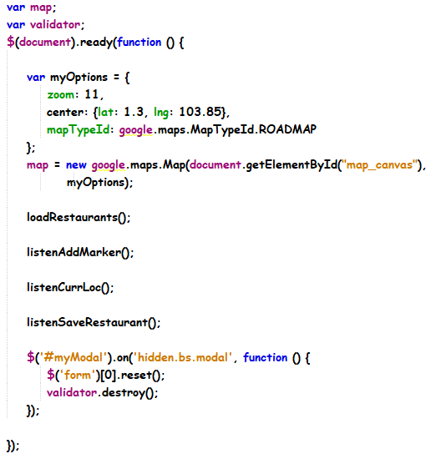
restaurantsMap.js - continue
Reset the form fields and clear any error messages when the modal is hidden

Slide 14
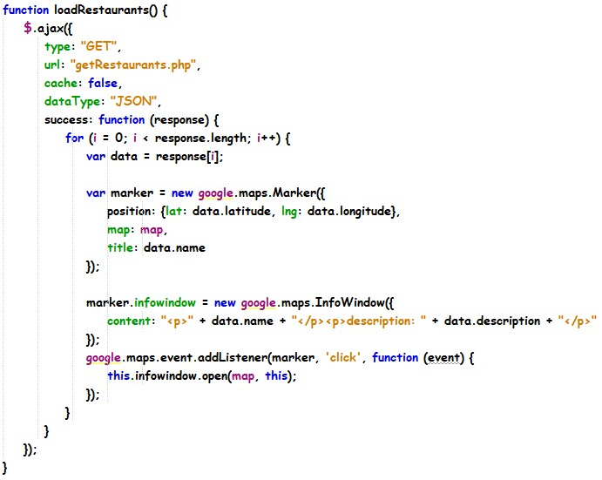
restaurantsMap.js - continue
Attach infowindow to current marker
“this” refers to the current marker

Slide 15
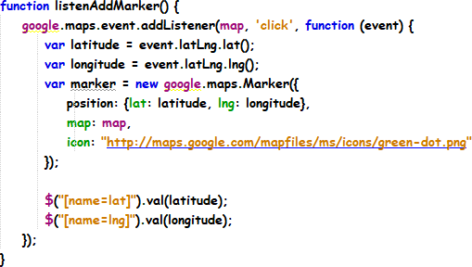
restaurantsMap.js - continue

Slide 16
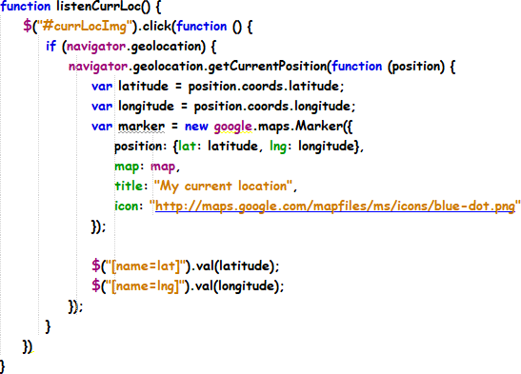
restaurantsMap.js - continue

Slide 17
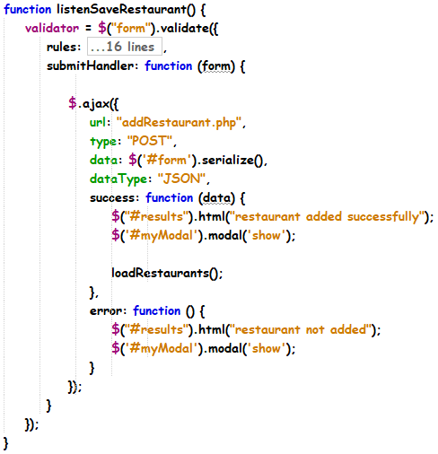
restaurantsMap.js - continue

Slide 18
Summary
Apply Geolocation API to get user’s current location
Setup and modify Google Map
Manipulate GoogleMap by adding markers and events
Display user’s current location on the Google Map using Geolocation API

